Slide 2

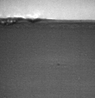
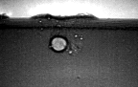
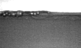
Yet another explanation: Dynamic transients taking place inside the material at high velocities
Conduction ⇨
unstable keyhole
Pores removal
Conduction ⇨ keyhole
Deep keyhole
All videos from Empa- LAMP
Materials processing with intelligent systems (MICRO-457) Shevchik S. & Hoffmann P.

Slide 3
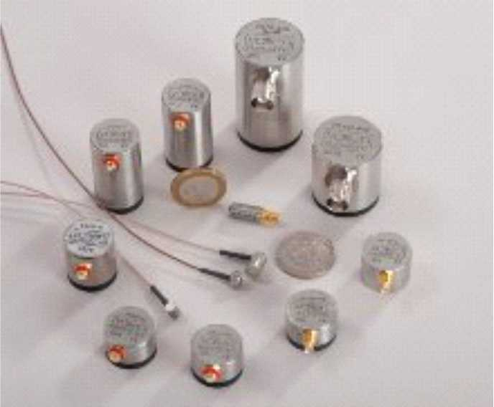
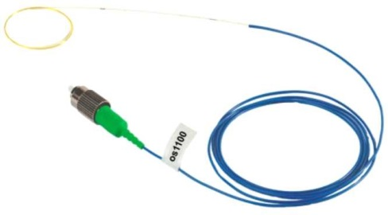
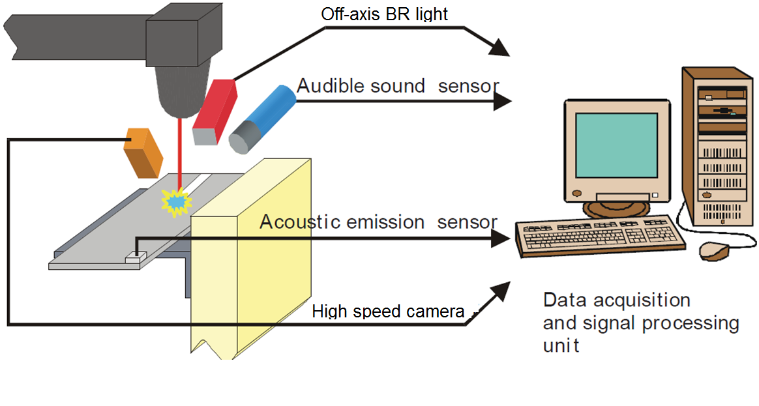
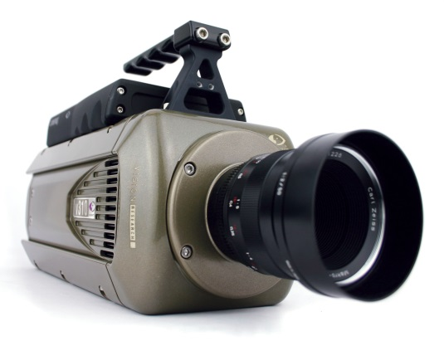
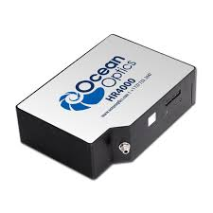
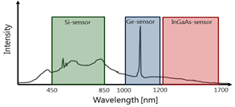

One way to tackle these difficulties: Add sensors
Sensors
Acoustic
General Setup
You name it!
Piezo optical fibre
High speed imaging
Optical sensors
OES
Photo-diode
Materials processing with intelligent systems (MICRO-457) Shevchik S. & Hoffmann P.

Slide 4
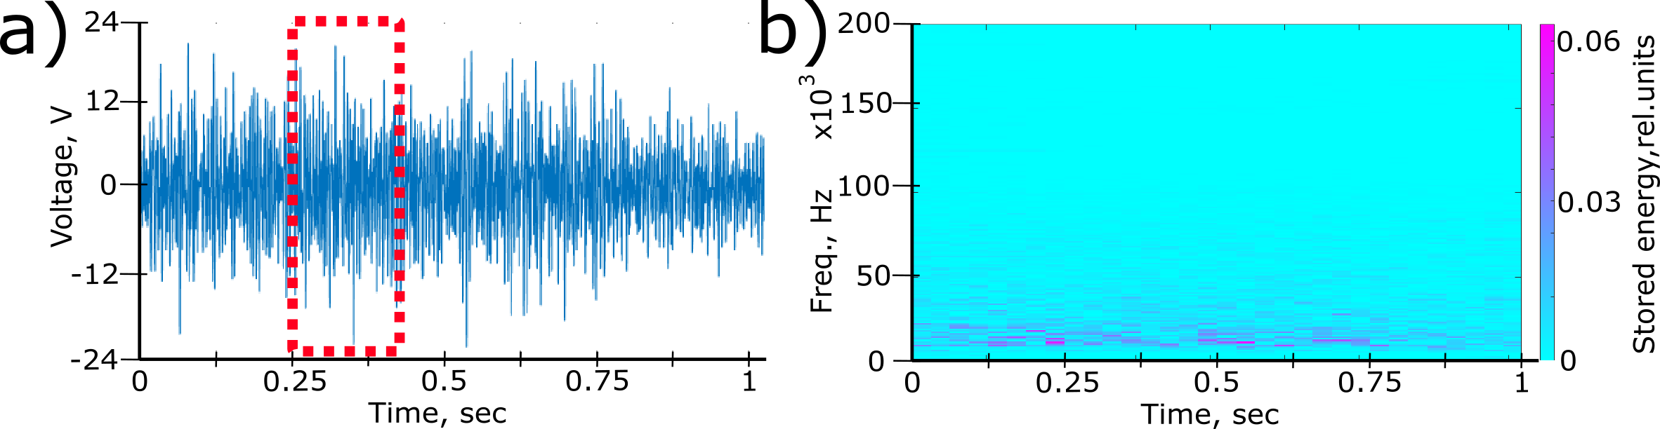
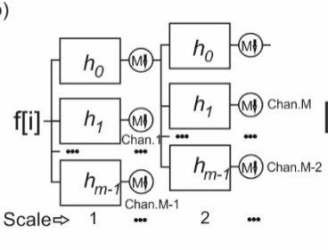
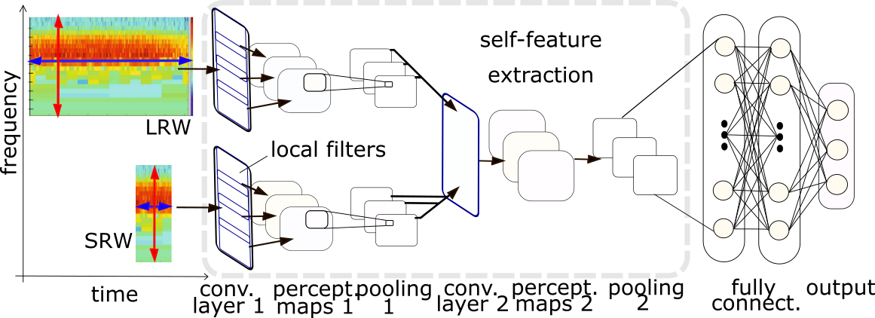
One way to tackle these difficulties: Signal processing
1.4
AE
Frequency (MHz)
Supervised learning
  Infers a function from labelled training data.
  Typical supervised learning
    Support Vector Machine (SVM)
    Decision tree (Random forest, gradient boost)
    Deep Neural Network (CNN, SCNN, …)
    Laplacian Graph (single kernel, multi-kernel (Empa))
Unsupervised (e.g. k-mean, autoencoders)
Reinforcement learning (game Go)
0
0
1
2
3
4
5
6
BR
Materials processing with intelligent systems (MICRO-457) Shevchik S. & Hoffmann P.

Slide 5
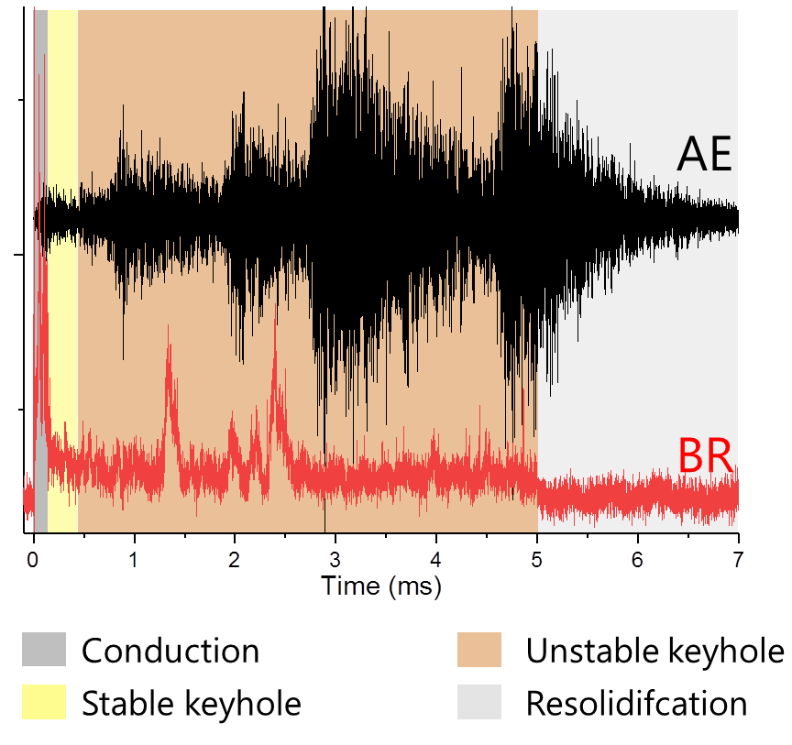
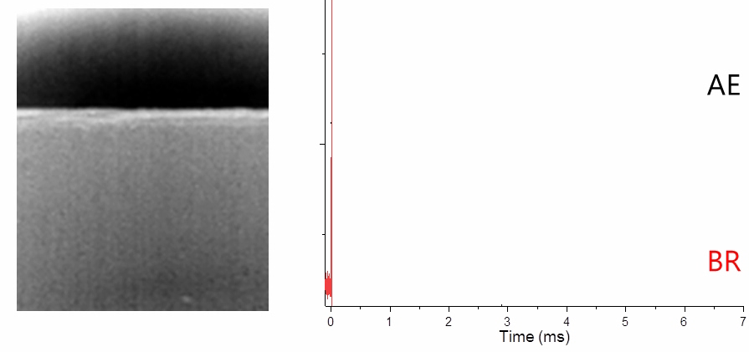
But linking signal to event is a real challenge
Aluminum plate 2mm thick,
no gas shielding, room temperature
Keyhole experiment with defects
Laser 1070 nm, pulse length 10 ms,
laser spot ∅ 30 μm
ESRF ID19 X-ray beam
Materials processing with intelligent systems (MICRO-457) Shevchik S. & Hoffmann P.

Slide 6
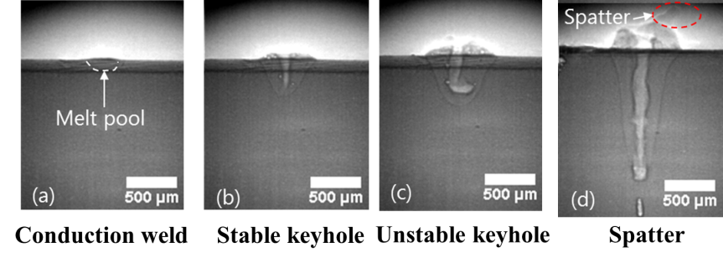
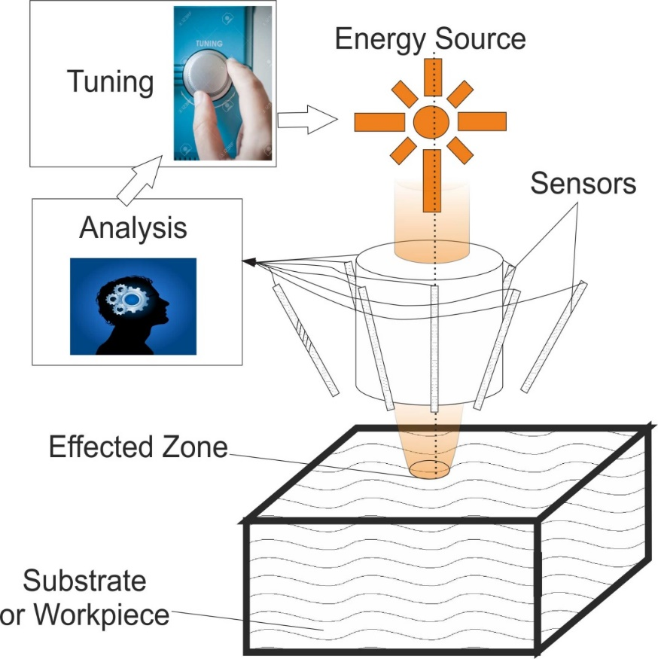
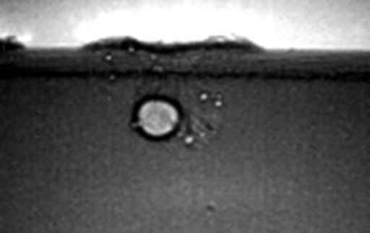

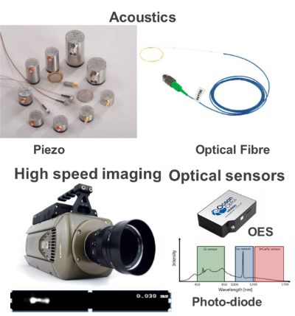

The final objective: Realise the dreams of companies
Classification tasks
Process runs
Get signal from the workpiece
Analysis of the signals
Prediction of the defects creation
Tune the laser power
Ideally no human intervention!
You name it!
(e)
Machine learning / Artificial intelligence
Human
intelligence
Sensors
Pore formation
Materials processing with intelligent systems (MICRO-457) Shevchik S. & Hoffmann P.

Slide 7
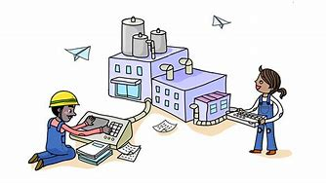






What is the team to achieve this goal?
A process engineer
An excellent technician/ engineer
A laser physicist
A conductor /
A translator
An optics specialist
An acoustic specialist
A material scientist
Materials processing with intelligent systems (MICRO-457) Shevchik S. & Hoffmann P.

Slide 8
Contents of the lecture
Laser processing
  Laser Principles
  Laser types (e.g. fs, ps, ns, ms, continuous)
Sensors
  Acoustics (use, type, else)
  Optics
  Opto-acoustic (in particular Fiber Bragg Grating)
  Visual
Materials processing with intelligent systems (MICRO-457) Shevchik S. & Hoffmann P.

Slide 9
Contents of the lecture
Data acquisition
  Principles
  Possibilities, limits
Introduction to machine learning
  Linear regression
  Supervised methods
  Semi-supervised methods
  Unupservised methods
  Reinforcement learning
Materials processing with intelligent systems (MICRO-457) Shevchik S. & Hoffmann P.

Slide 10
Contents of the lecture
A complete example of the approach for
  Laser welding
  Additive manufacturing
Materials processing with intelligent systems (MICRO-457) Shevchik S. & Hoffmann P.

Slide 11
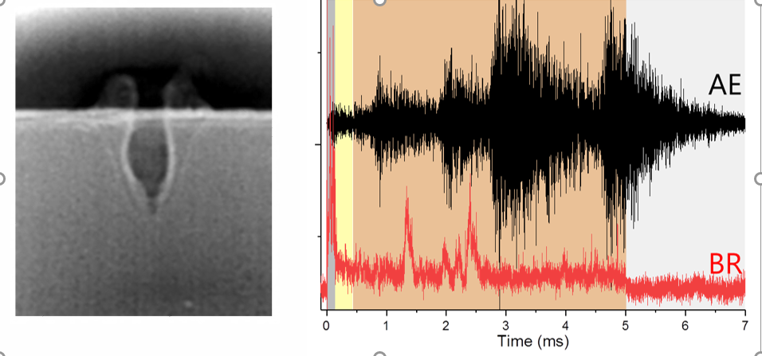
So le’ts start?
Materials processing with intelligent systems (MICRO-457) Shevchik S. & Hoffmann P.

